Slide 1
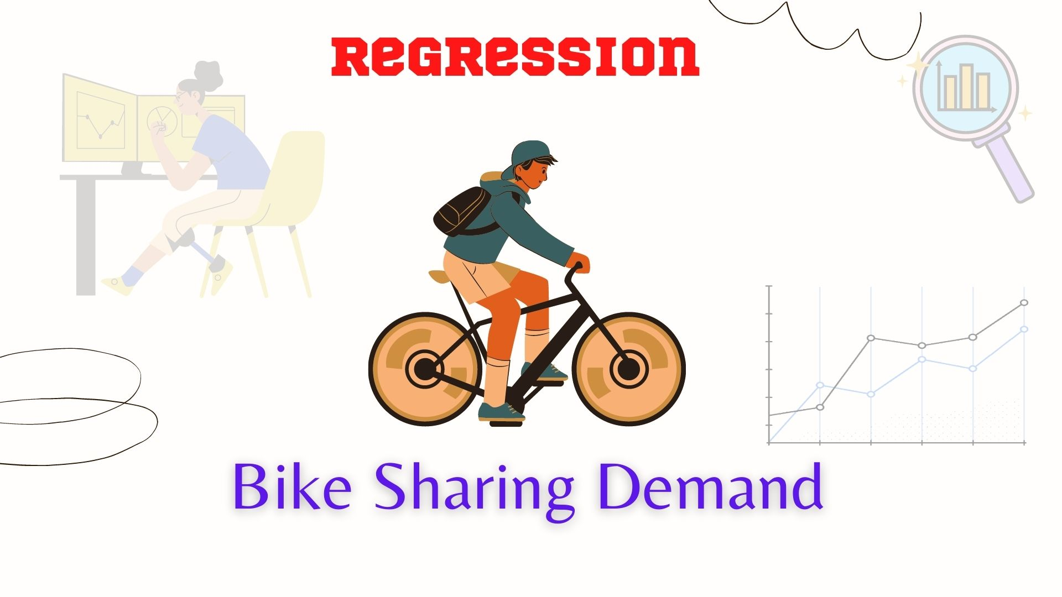
Bike Sharing Demand Analysis
Bike Sharing Demand Analysis
Next Hikes IT Solutions
Name : Anshita Srivastava Course : DATA SCIENCE Date : 24.03.2026

Slide 2
Introduction
This project analyzes bike-sharing data to uncover rental demand patterns by examining factors such as time, weather, and user type. Using statistical and machine learning models, it predicts demand based on historical data to optimize bike inventory and resources. The study supports urban mobility, smart city development, sustainable transport, and forecasting, helping bike-sharing companies meet customer needs while maximizing efficiency and revenue.

Slide 3
Problem Statement
Bike-sharing companies struggle to predict fluctuating
rental demand.
Demand depends on time, weather, and user type.
Poor prediction causes resource misallocation and
lost revenue.
The challenge is to build a predictive model for
accurate demand forecasting.

Slide 4
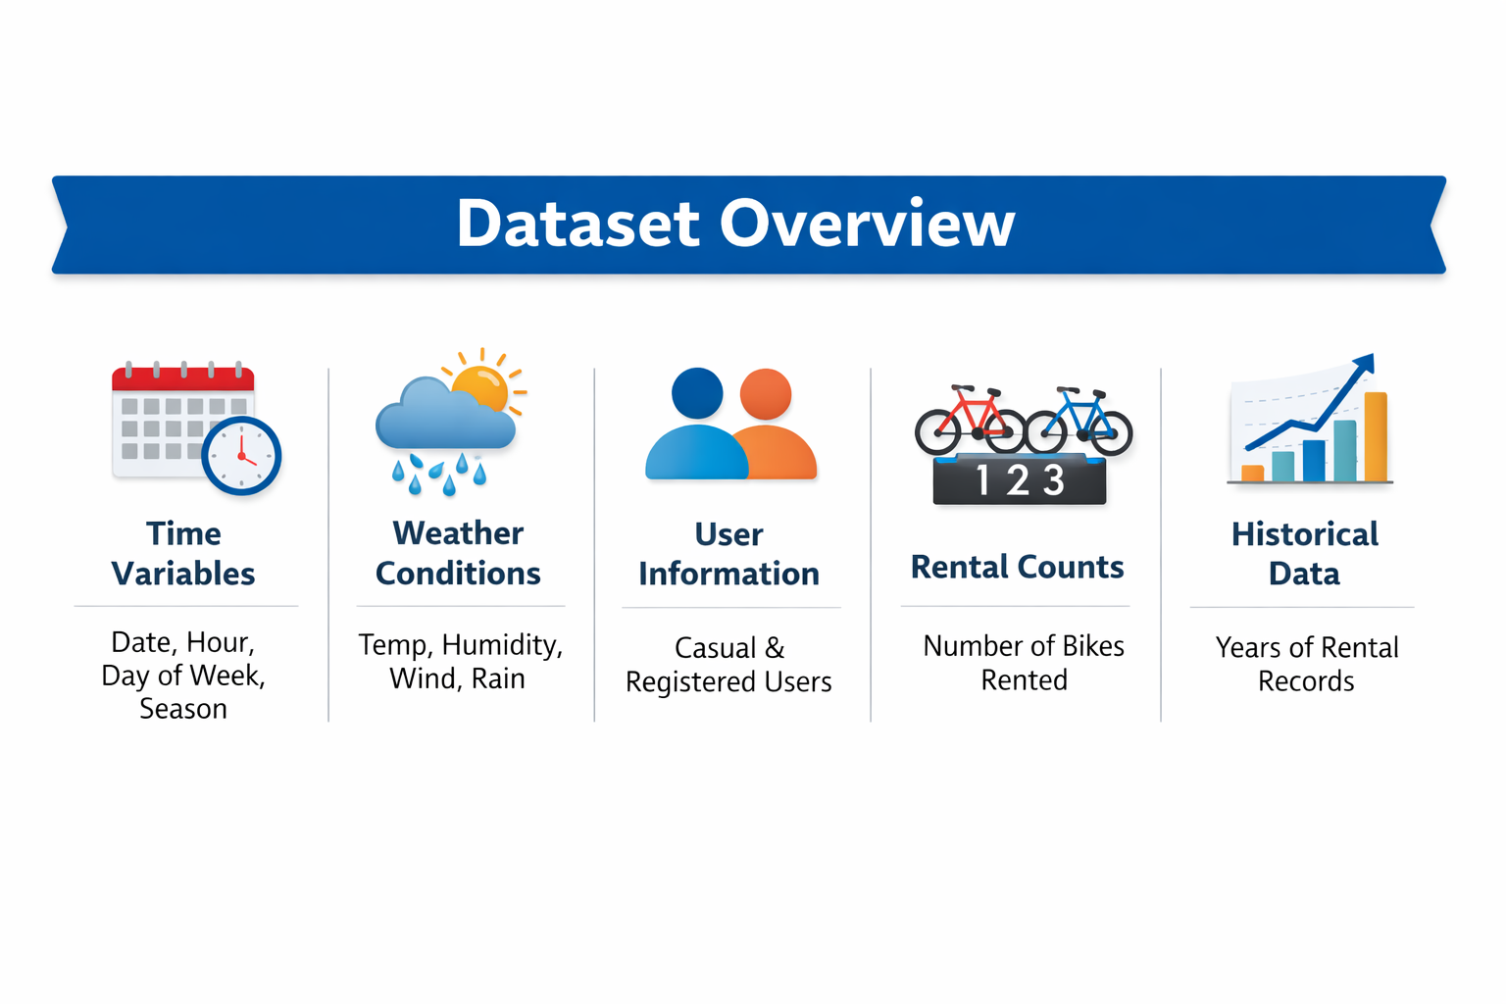
Dataset Overview

Slide 5

Data Cleaning
Handle Missing Values – Remove or fill null entries.
Fix Data Types – Ensure correct formats (For Ex- date, numeric).
Remove Duplicates – Eliminate repeated records.
Normalize Data – Standardize units and scales.
Filter Outliers – Detect and manage anomalies.

Slide 6
Data Merging
Combine Multiple Sources – Merge datasets like
weather, rental logs, and user info.
Align Time Stamps – Ensure all data shares a
common time format for accurate merging.
Join on Keys – Use shared columns (date, hour)
to link datasets.
Resolve Conflicts – Handle overlapping or
inconsistent entries during merge.
Verify Integrity – Check merged data for
completeness and correctness.

Slide 7
Key Features Created
Hour Bins – Grouped hours into peak and
off-peak slots.
Day Type – Labeled days as weekday, weekend,
or holiday.
Weather Index – Combined weather metrics into
a single score.
User Ratio – Ratio of casual to registered users.
Lag Features – Previous rental counts to capture
trends.

Slide 8
Analysis - Hourly Demand
Peak Hours – Morning and evening rush show
highest rentals.
Off-Peak Hours – Midday and late-night demand
is lower.
Weekday vs. Weekend – Usage patterns differ
across day types.
Weather Impact – Hourly demand shifts with
temperature, rain, humidity.
User Type Trends – Casual vs. registered users
show distinct hourly behaviors.

Slide 9
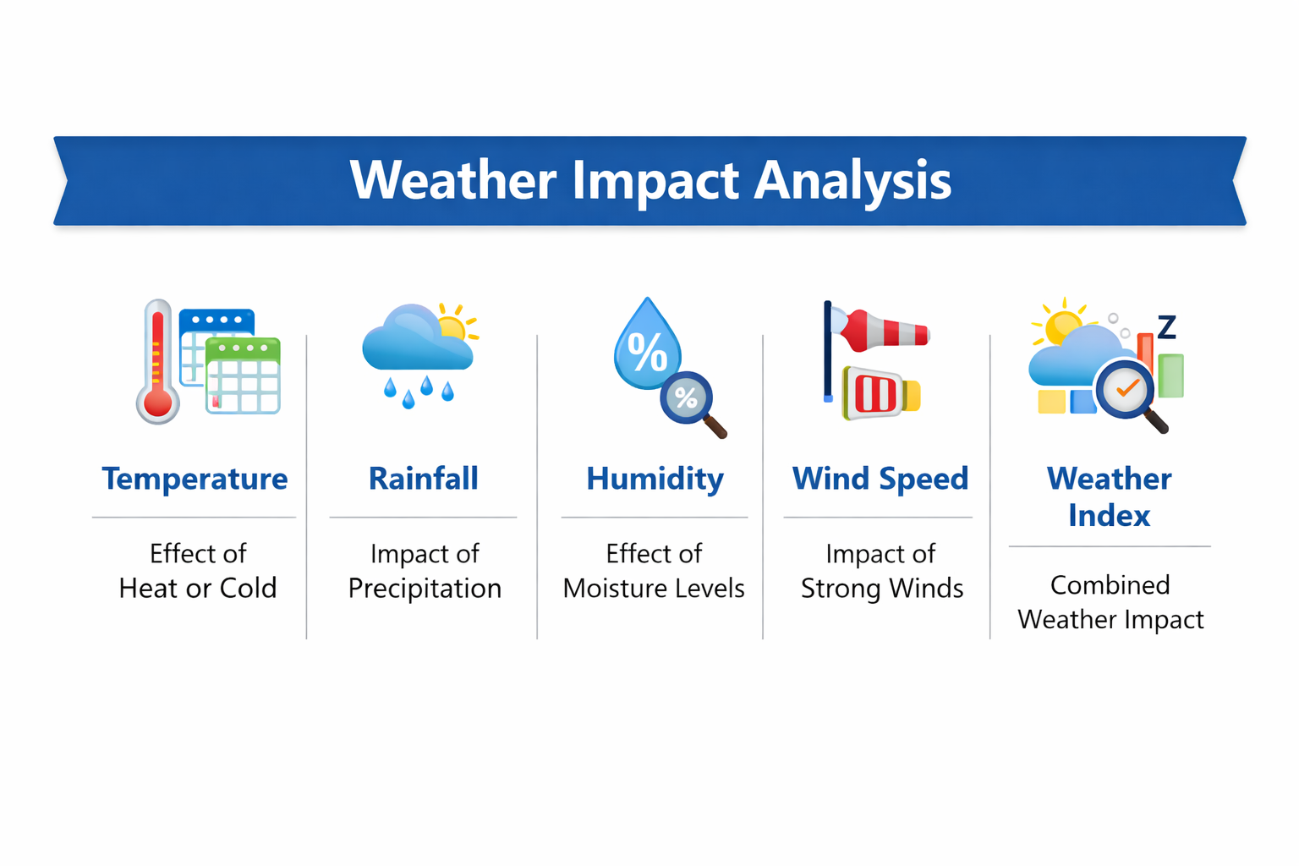
Analysis - Weather Impact
Bad weather like rain or strong wind reduces bike rentals.
Pleasant weather boosts demand, especially from casual
users.

Slide 10
Analysis - Monthly Trend
Bike rentals are highest in warmer months like May
to September.
Winter months show lower demand due to cold and
weather conditions.

Slide 11
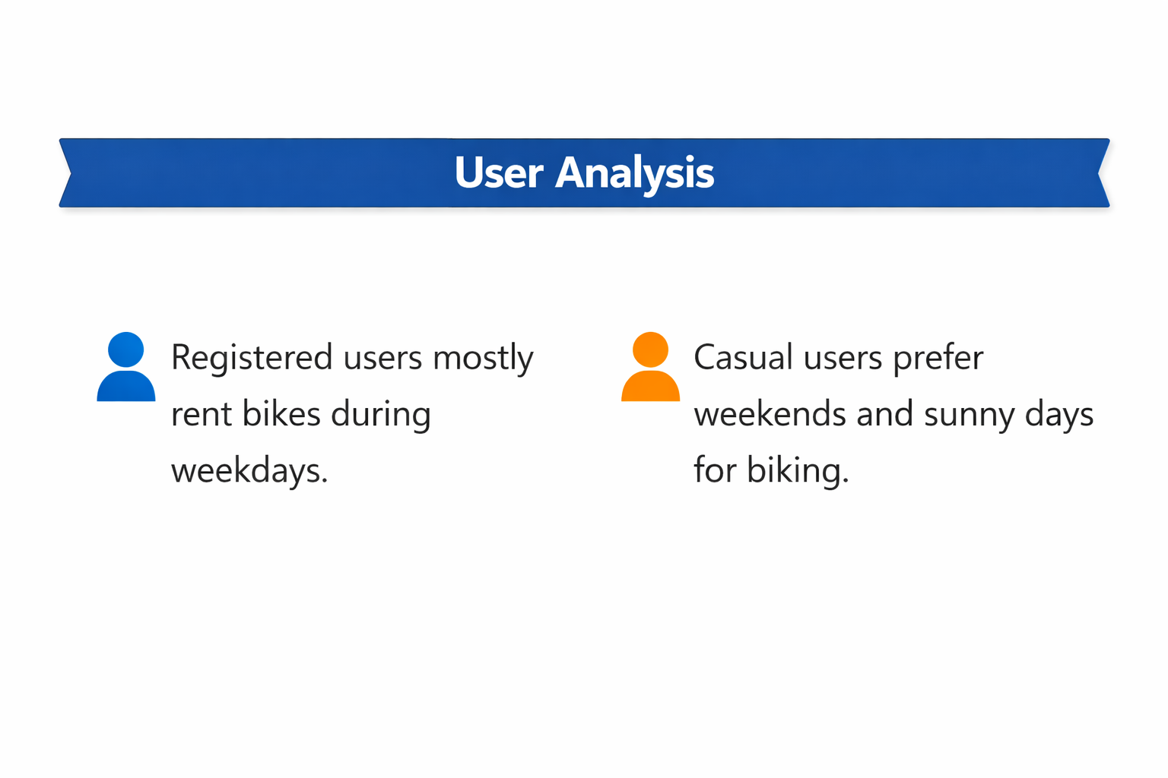
User Analysis
Casual users ride more on weekends and in
good weather.
Registered users show consistent patterns
across weekdays.

Slide 12
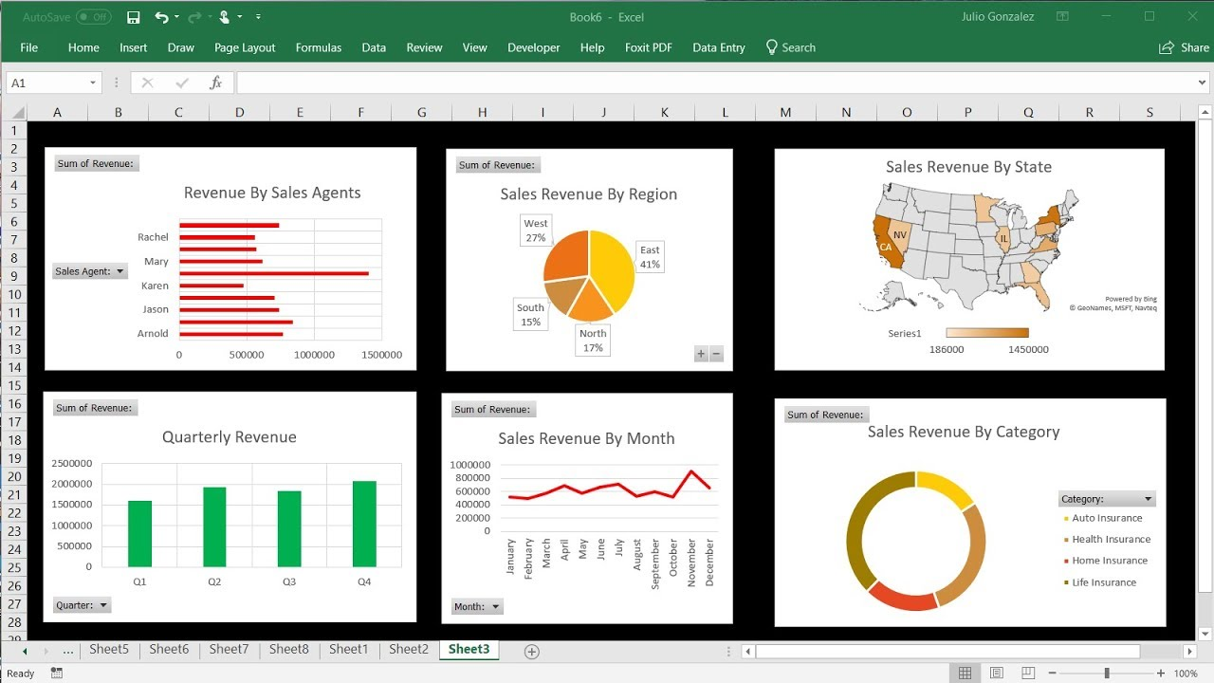
Tools Used
Microsoft Excel
Pivot Tables
Power Query
Charts and Visualization
Slicers for interactivity

Slide 13
Final Results & Conclusion
The model predicts bike demand with good accuracy.
Weather and user type are key factors in demand.
Feature engineering improved model performance.
Dashboard helps visualize trends and user behavior.
Project supports smart planning for bike-sharing
systems.

Slide 14


